Slide 1
Building Labs for Active Directory and PowerShell Testing
Section 1

Slide 2
In this Section, we are going to take a look at…
Basics of physical and virtual labs and their importance
Expanding on the virtual lab environment
Lab creation using VirtualBox
Lab creation using VirtualBox
Server OS installation
Active directory environment creation

Slide 3
Physical Versus Virtual Labs and Their Importance for Active Directory

Slide 4
In this Video, we are going to take a look at…
Benefits and limitations of physical lab environments

Slide 5
In this Video, we are going to take a look at…
Benefits and limitations of physical lab environments
Benefits and limitations of virtual lab environments

Slide 6
In this Video, we are going to take a look at…
Benefits and limitations of physical lab environments
Benefits and limitations of virtual lab environments
Importance of having a lab environment for Active Directory

Slide 7
Physical Lab Environments
Requirements
Space
Power
PC hardware
Network hardware
Notes:
This is a step-wise graphical info type slide.

Slide 8
Physical Lab Environments
Setup
Requirements
Physical layout
Software/OS setup
Space
Power
PC hardware
Network hardware
Notes:
This is a step-wise graphical info type slide.

Slide 9
Physical Lab Environments
Maintenance
Setup
Most changes require time and labor to modify layout or equipment
Requirements
Physical layout
Software/OS setup
Space
Power
PC hardware
Network hardware
Notes:
This is a step-wise graphical info type slide.

Slide 10
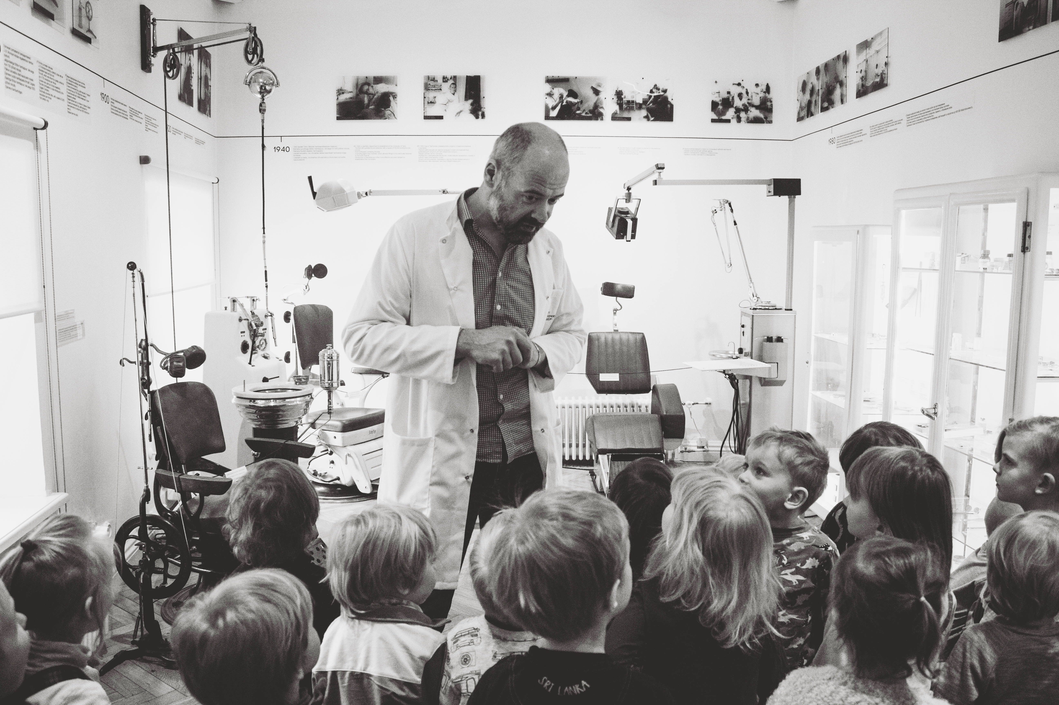
Notes:
Something that needs to grab the viewers attention!!

Slide 11
Virtual Lab Environments
Requirements
Computing power
Disk space
Hypervisor
Notes:
This is a step-wise graphical info type slide.

Slide 12
Virtual Lab Environments
Setup
Requirements
Hypervisor install
Virtual network and machine creation
Computing power
Disk space
Hypervisor
Notes:
This is a step-wise graphical info type slide.

Slide 13
Virtual Lab Environments
Maintenance
Setup
Most changes require minimal time to create or remove virtual hardware
Requirements
Hypervisor install
Virtual network and machine creation
Computing power
Disk space
Hypervisor
Notes:
This is a step-wise graphical info type slide.

Slide 14
Virtual Labs Provide Agility to Test Quickly
Notes:
Something that needs to grab the viewers attention!!

Slide 15
Physical labs are slow to set up and change, having many requirements such as space and power

Slide 16
Physical labs are slow to set up and change, having many requirements such as space and power
Virtual labs are agile and fast to deploy

Slide 17
Physical labs are slow to set up and change, having many requirements such as space and power
Virtual labs are agile and fast to deploy
Having a lab environment is critical for testing!

Slide 18
Hypervisors, Virtualization, and Active Directory
Next Video

